Slide 1

CSE 470/598 Hierarchical Modeling
Ross Maciejewski
rmacieje@asu.edu

Slide 2
Disclaimer
These slides can only be used as study material for the class 470 at ASU
The slides cannot be distributed or used for another purpose

Slide 3
Objectives
Examine the limitations of linear modeling
Symbols and instances
Introduce hierarchical models
Articulated models
Robots
Introduce Tree and DAG models

Slide 4
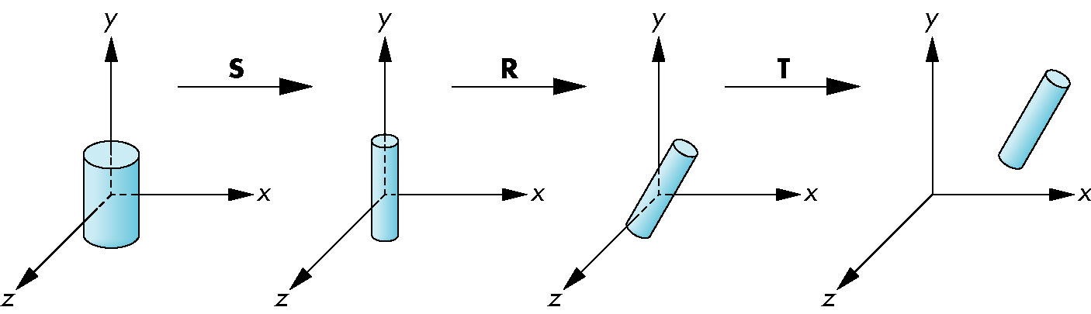
Instance Transformation
Start with a prototype object (a symbol)
Each appearance of the object in the model is an instance
Must scale, orient, position
Defines instance transformation

Slide 5
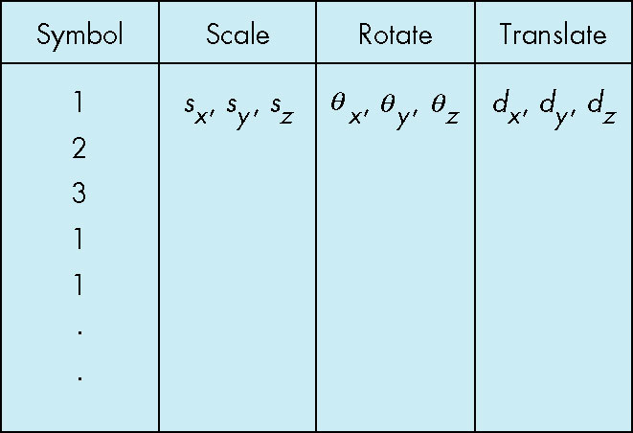
Symbol-Instance Table
Can store a model by assigning a number to each symbol and storing the parameters for the instance transformation

Slide 6
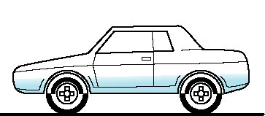
Relationships in Car Model
Symbol-instance table does not show relationships between parts of model
Consider model of car
Chassis + 4 identical wheels
Two symbols
Rate of forward motion determined by rotational speed of wheels

Slide 7
Structure Through Function Calls
car(speed) {
chassis()
wheel(right_front);
wheel(left_front);
wheel(right_rear);
wheel(left_rear);
}
Fails to show relationships well
Look at problem using a graph

Slide 8
Graphs
Set of nodes and edges (links)
Edge connects a pair of nodes
Directed or undirected
Cycle: directed path that is a loop
loop

Slide 9
Tree
Graph in which each node (except the root) has exactly one parent node
May have multiple children
Leaf or terminal node: no children
root node
leaf node

Slide 10
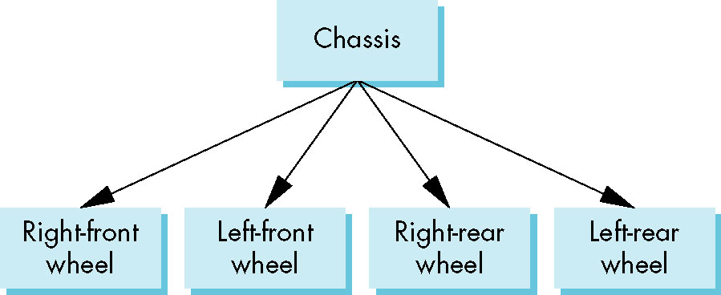
Tree Model of Car

Slide 11
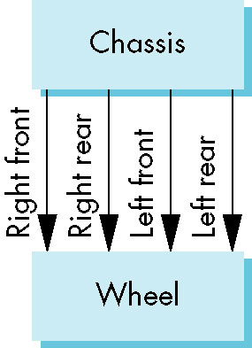
DAG Model
If we use the fact that all the wheels are identical, we get a directed acyclic graph
Not much different than dealing with a tree

Slide 12
Modeling with Trees
Must decide what information to place in nodes and what to put in edges
Nodes
What to draw
Pointers to children
Edges
May have information on incremental changes to transformation matrices (can also store in nodes)

Slide 13
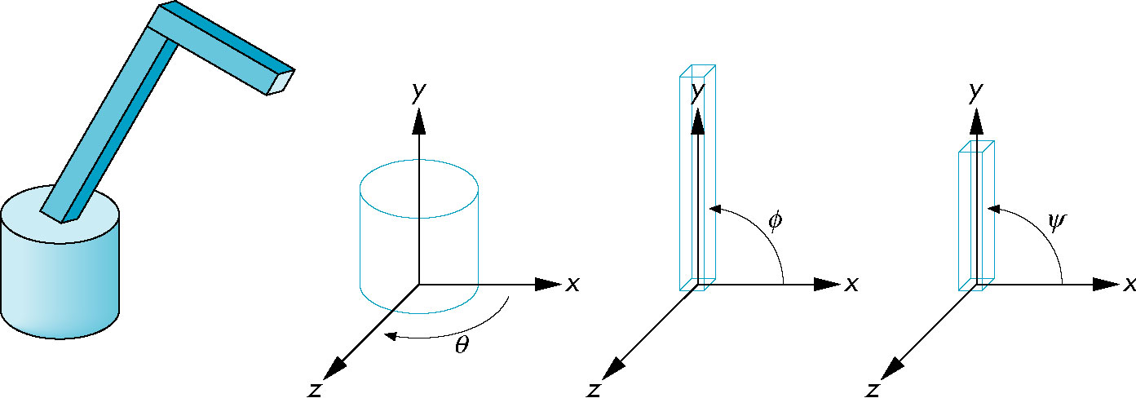
Robot Arm
parts in their own
coodinate systems
robot arm

Slide 14
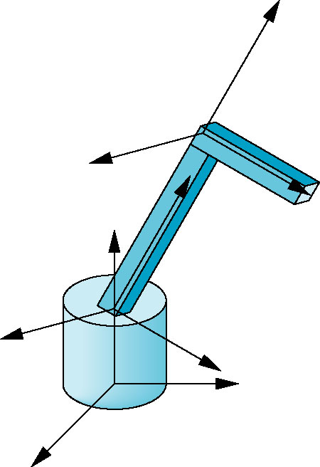
Articulated Models
Robot arm is an example of an articulated model
Parts connected at joints
Can specify state of model by giving all joint angles

Slide 15
Relationships in Robot Arm
Base rotates independently
Single angle determines position
Lower arm attached to base
Its position depends on rotation of base
Must also translate relative to base and rotate about connecting joint
Upper arm attached to lower arm
Its position depends on both base and lower arm
Must translate relative to lower arm and rotate about joint connecting to lower arm

Slide 16
Required Matrices
Rotation of base: R_{b}
Apply M = R_{b} to base
Translate lower arm relative to base: T_{lu}
Rotate lower arm around joint: R_{lu}
Apply M = R_{b} T_{lu} R_{lu} to lower arm
Translate upper arm relative to upper arm: T_{uu}
Rotate upper arm around joint: R_{uu}
Apply M = R_{b} T_{lu} R_{lu} T_{uu} R_{uu} to upper arm

Slide 17
OpenGL Code for Robot
robot_arm() {
glRotate(theta, 0.0, 1.0, 0.0);
base();
glTranslate(0.0, h1, 0.0);
glRotate(phi, 0.0, 1.0, 0.0);
lower_arm();
glTranslate(0.0, h2, 0.0);
glRotate(psi, 0.0, 1.0, 0.0);
upper_arm();
}

Slide 18
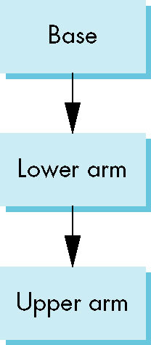
Tree Model of Robot
Note code shows relationships between parts of model
Can change “look” of parts easily without altering relationships
Simple example of tree model
Want a general node structure for nodes

Slide 19
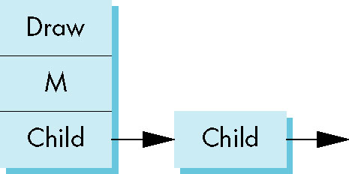
Possible Node Structure
Code for drawing part or
pointer to drawing function
linked list of pointers to children
matrix relating node to parent

Slide 20
Generalizations
Need to deal with multiple children
How do we represent a more general tree?
How do we traverse such a data structure?
Animation
How to use dynamically?
Can we create and delete nodes during execution?

Slide 21
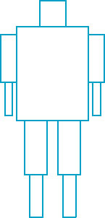
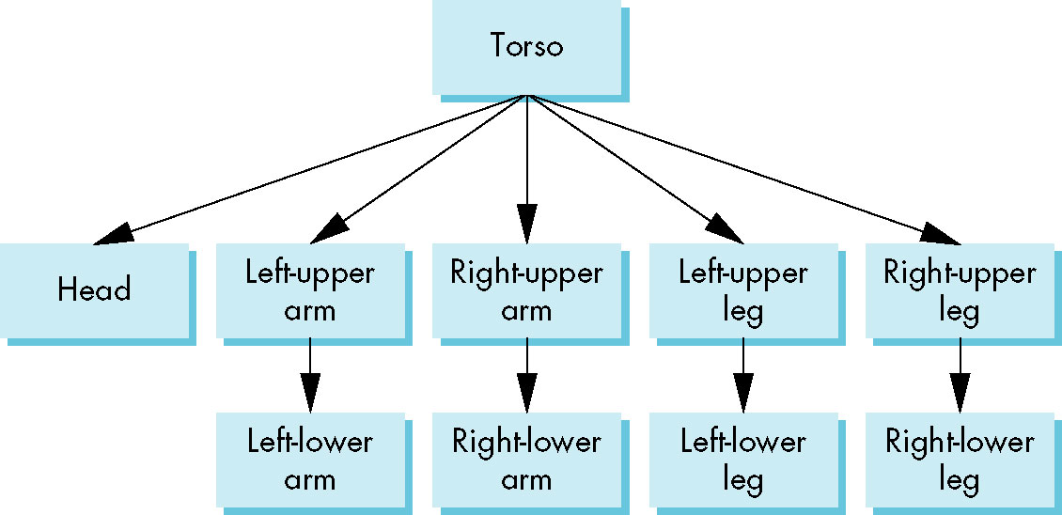
Humanoid Figure

Slide 22
Building the Model
Can build a simple implementation using quadrics: ellipsoids and cylinders
Access parts through functions
torso()
left_upper_arm()
Matrices describe position of node with respect to its parent
M_{lla} positions left lower leg with respect to left upper arm

Slide 23
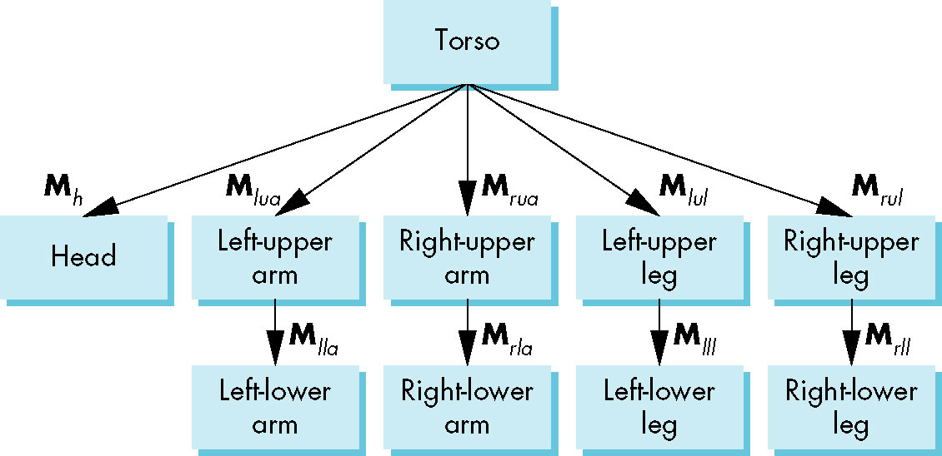
Tree with Matrices

Slide 24
Display and Traversal
The position of the figure is determined by 11 joint angles (two for the head and one for each other part)
Display of the tree requires a graph traversal
Visit each node once
Display function at each node that describes the part associated with the node, applying the correct transformation matrix for position and orientation

Slide 25
Transformation Matrices
There are 10 relevant matrices
M positions and orients entire figure through the torso which is the root node
M_{h} positions head with respect to torso
M_{lua}, M_{rua}, M_{lul}, M_{rul} position arms and legs with respect to torso
M_{lla}, M_{rla}, M_{lll}, M_{rll} position lower parts of limbs with respect to corresponding upper limbs

Slide 26
Stack-based Traversal
Set model-view matrix to M and draw torso
Set model-view matrix to MM_{h} and draw head
For left-upper arm need MM_{lua} and so on
Rather than recomputing MM_{lua} from scratch or using an inverse matrix, we can use the matrix stack to store M and other matrices as we traverse the tree

Slide 27
Traversal Code
figure() {
glPushMatrix()
torso();
glRotate3f(…);
head();
glPopMatrix();
glPushMatrix();
glTranslate3f(…);
glRotate3f(…);
left_upper_arm();
glPopMatrix();
glPushMatrix();
save present model-view matrix
update model-view matrix for head
recover original model-view matrix
save it again
update model-view matrix
for left upper arm
recover and save original
model-view matrix again
rest of code

Slide 28
Analysis
The code describes a particular tree and a particular traversal strategy
Can we develop a more general approach?
Note that the sample code does not include state changes, such as changes to colors
May also want to use glPushAttrib and glPopAttrib to protect against unexpected state changes affecting later parts of the code

Slide 29
General Tree Data Structure
Need a data structure to represent tree and an algorithm to traverse the tree
We will use a left-child right sibling structure
Uses linked lists
Each node in data structure is two pointers
Left: next node
Right: linked list of children

Slide 30
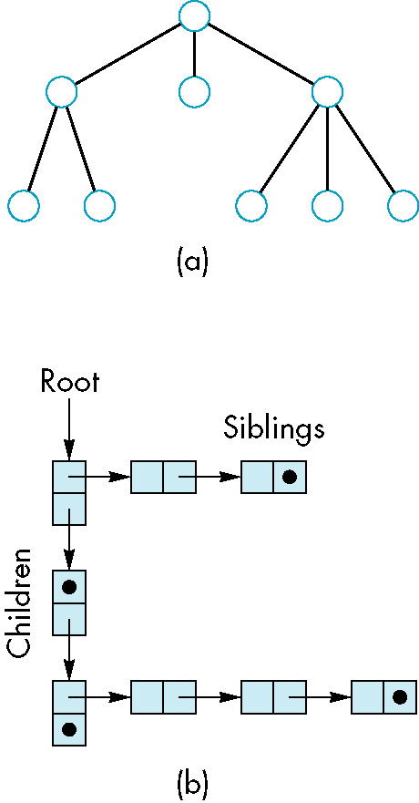
Left-Child Right-Sibling Tree

Slide 31
Tree node Structure
At each node we need to store
Pointer to sibling
Pointer to child
Pointer to a function that draws the object represented by the node
Homogeneous coordinate matrix to multiply on the right of the current model-view matrix
Represents changes going from parent to node
In OpenGL this matrix is a 1D array storing matrix by columns

Slide 32
C Definition of treenode
typedef struct treenode
{
GLfloat m[16];
void (*f)();
struct treenode *sibling;
struct treenode *child;
} treenode;

Slide 33
Defining the torso node
treenode torso_node, head_node, lua_node, … ;
/* use OpenGL functions to form matrix */
glLoadIdentity();
glRotatef(theta[0], 0.0, 1.0, 0.0);
/* move model-view matrix to m */
glGetFloatv(GL_MODELVIEW_MATRIX, torso_node.m)
torso_node.f = torso; /* torso() draws torso */
Torso_node.sibling = NULL;
Torso_node.child = &head_node;

Slide 34
Notes
The position of figure is determined by 11 joint angles stored in theta[11]
Animate by changing the angles and redisplaying
We form the required matrices using glRotate and glTranslate
More efficient than software
Because the matrix is formed in model-view matrix, we may want to first push original model-view matrix on matrix stack

Slide 35
Preorder Traversal
void traverse(treenode *root)
{
if(root == NULL) return;
glPushMatrix();
glMultMatrix(root->m);
root->f();
if(root->child != NULL)
traverse(root->child);
glPopMatrix();
if(root->sibling != NULL)
traverse(root->sibling);
}

Slide 36
Notes
We must save model-view matrix before multiplying it by node matrix
Updated matrix applies to children of node but not to siblings which contain their own matrices
The traversal program applies to any left-child right-sibling tree
The particular tree is encoded in the definition of the individual nodes
The order of traversal matters because of possible state changes in the functions

Slide 37
Dynamic Trees
If we use pointers, the structure can be dynamic
typedef treenode *tree_ptr;
tree_ptr torso_ptr;
torso_ptr = malloc(sizeof(treenode));
Definition of nodes and traversal are essentially the same as before but we can add and delete nodes during execution

Slide 38
Why hierarchical data structures?
Organize geometry in n-dimensional space (2D and 3D)
Traverse the scene hierarchy top-down
Occlusion culling / View frustum culling
Shadow generation / transparency
Ray tracing intersection tests
Collision detection
Point location (what is the nearest point?)

Slide 39
Overview of Hierarchical Data Structures
Quadtree
Octree
Bounding Volume Hierarchy (BVH)
Binary Space Partitioning Trees (BSP trees)
kD-trees
Voronoi Diagrams / Delauney Triangulation

Slide 40
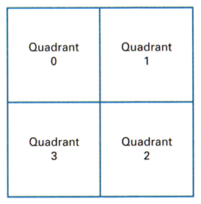
Quadtrees
Hierarchical data structure to manage space
Quadtree is 2D
Hierarchical subdivision until a region is homogeneous
Root node
Q = [xmin : xmax] x [ymin : ymax]
Each internal node has 4 children

Slide 41
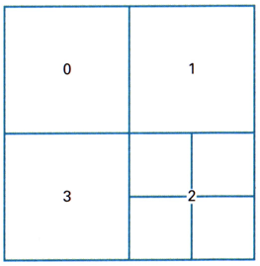
Quadtrees
E.g. Quatree for black and white images
area with 2^{n} by 2^{n} pixels ⇒ quadtree with n levels
storage efficiency
My notation:
root
0
1
2
3
0
1
2
3

Slide 42
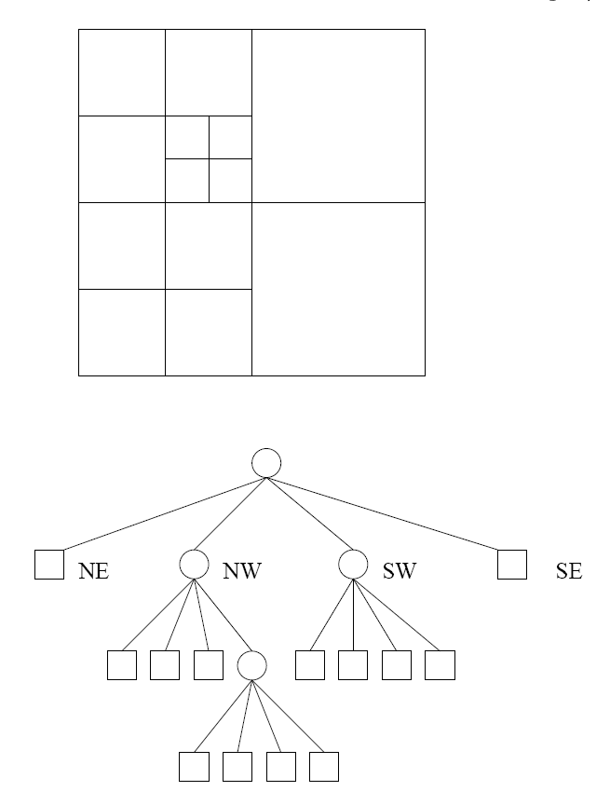
Example

Slide 43
Quadtree for an Image Example
How does the quadtree look like?

Slide 44
Quadtree for an Image Example
suitable for representing (2D) images

Slide 45
Octree
regular space subdivision:
simple (empty or uniform) ⇒ leaf node
complex (other cases) ⇒ divide further

Slide 46
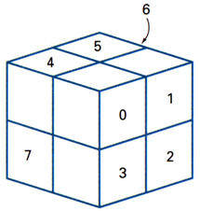
Octrees
Octree divides 3D cube into octants
Volume elements (= voxels, similar to pixel)
Set operations easy on octrees
Geometric transformations difficult on octrees
region of a 3-dim. space

Slide 47
Octree Simple Example
Octrees and Quadtrees are very similar
Quadtrees are prefered for illustration purposes
Variant: split voxel in 3x3 voxels instead of 2x2

Slide 48
Operations with Octrees
transformations
very complicated except for a few special cases, e.g. rotation by 90°, mirroring at a subdivision plane, scalation by 2^{n}
combinations
very simple: if A or B homogeneous ⇒ simple rules else combine recursively all 8 octants of A and B

Slide 49

Properties of Octrees
advantages
combinations very simple
fast rendering
spatial search possible
disadvantages
inexact representation
low image quality
restricted transformations
high memory cost

Slide 50
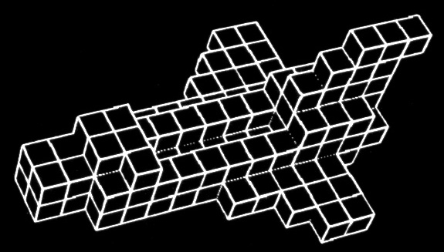
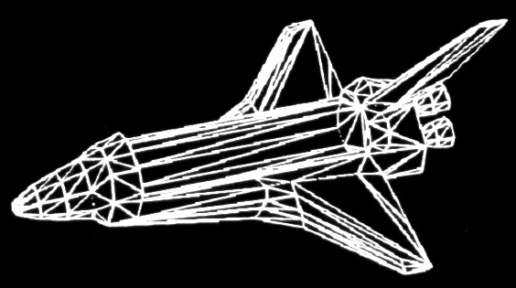
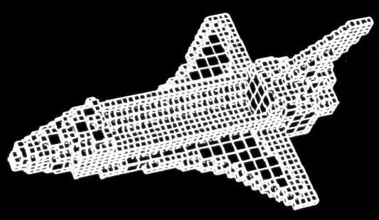
Octree Example
(c) Yoshifumi Kitamura

Slide 51
Rendering of Octrees
algorithm:
if octree node is full: draw the cube
if octree node is empty: do nothing
if octree node is inhomogeneous: render the 8 octants from back to front

Slide 52
Quadtree for Points
Instead of marking squares as full or empty:
Internal nodes
Leaf nodes with one point or no point
Variation leaf node list of points

Slide 53
Quadtree for Triangles
Objects (Triangles) are at leaf nodes
Problem: Object (Triangle) intersects splitting planes
Object can be stored higher up in the tree
Object can be split into two along splitting plane
Object can be stored with two different nodes
Object fits well in the tree
Object intersects splitting plane

Slide 54
Scene management with Quad / Octrees
Note: If new objects are inserted, existing objects in the tree can intersect the splitting plane
Object fits well in the tree
Object intersects splitting plane
new object inserted into tree

Slide 55
Mailboxes
Store object with two or more nodes
Use ID to avoid multiple consideration
Example:
Ray tracing, store last ray ID with each object
Use counter as ray ID

Slide 56
Quadtree / Octree Algorithms
Construction
Input: Image, set of points, set of triangles, …
Output: Quadtree organizing image, points, triangles, …
Neighborhood finding
Input: Quadtree cell
Output: Find neighbor to the north, south, east or west
Ray Shooting (for Quadtree / Octree with triangles)
Input: Ray with starting point ps and direction vector dir
Output: First triangle that intersects the ray

Slide 57
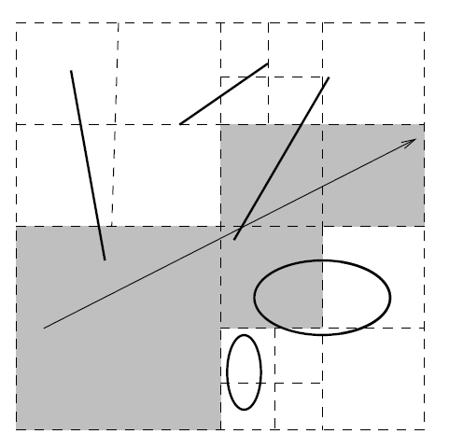
Ray shooting
Top down
Bottom up

Slide 58
Binary Space Partitioning (BSP) Trees
Main purpose – depth sorting
Consisting of a dividing plane, and a BSP tree on each side of the dividing plane (note the recursive definition)
The back to front traversal order can be decided right away according to where the eye is
P
back to front: A->P->B
BSP A
BSP B
back to front: A->P->B

Slide 59
BSP Trees
Two possible implementations:
Axis-Aligned BSP
Polygon-Aligned BSP
Intersecting?

Slide 60
Axis-Aligned BSP Trees
Starting with an AABB
Recursively subdivide into small boxes
One possible strategy: cycle through the axes (also called k-d trees)
0
D
E
1a
1b
B
2
1b
1a
A
B
C
2
A
0
C
Q: objects intersect the
boundaries?
D
E

Slide 61
Polygon-Aligned BSP Trees
The original BSP idea
Choose one divider at a time – any polygon intersect with the plane has to be split
Done recursively until all polygons are in the BSP trees
The back to front traversal can be done exact
The dividers need to be chosen carefully so that a balanced BSP tree is created
F
A
B
C
B
C
A
D
D
E
F
E

Slide 62
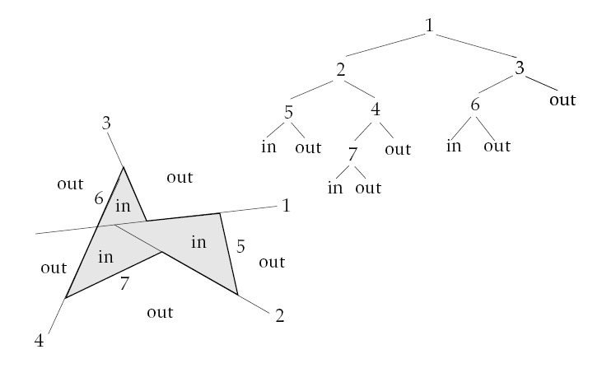
BSP for Convex Volumes

Slide 63
Bounding Volume Hierarchies
Bounding Volume (BV) – a volume that encloses a set of objects
The idea is to use a much similar geometric shape for quick tests (frustum culling for example)
Easy to compute, as tight as possible
AABB, Sphere – easy to compute, but poor fit
AABB
Sphere
OBB

Slide 64
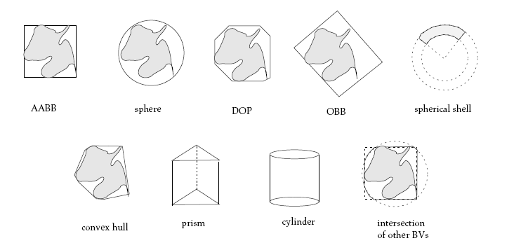
Bounding Volumes

Slide 65
Bounding Volume Hierarchies
Each node has a bounding volume that encloses the geometry in the entire subtree
The actual geometry is contained in the leaf node
Three types of methods: bottom-up, insertion, and top-down
This is essentially a clustering problem!
root
leaves

Slide 66
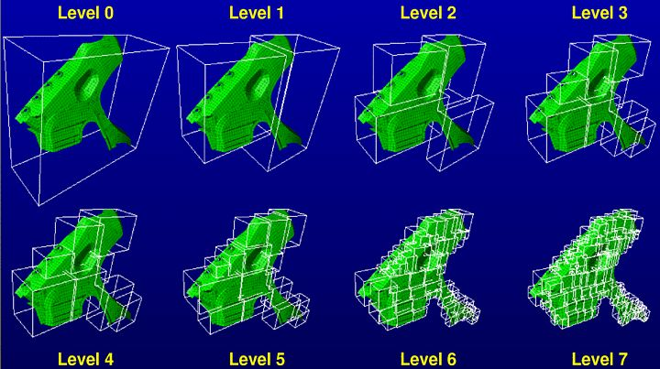
BVH in 3D: Example

Slide 67
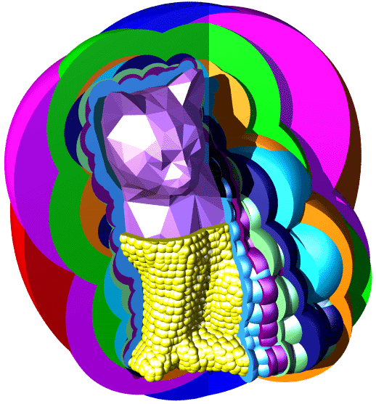
BVH in 3D: Example

Slide 68
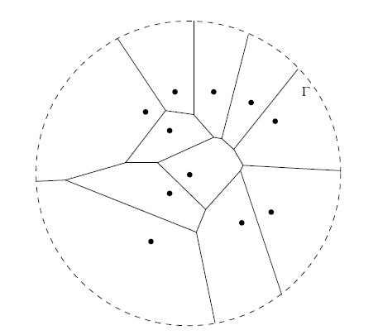
Voronoi Diagram / Delauney Triangulation

Slide 69
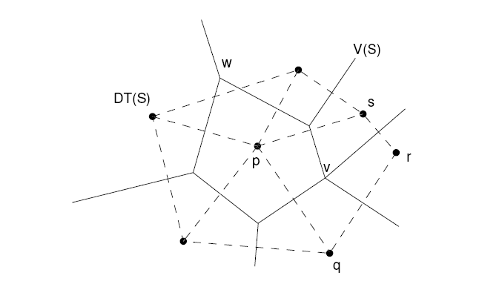
Delauney Triangulation

Slide 70
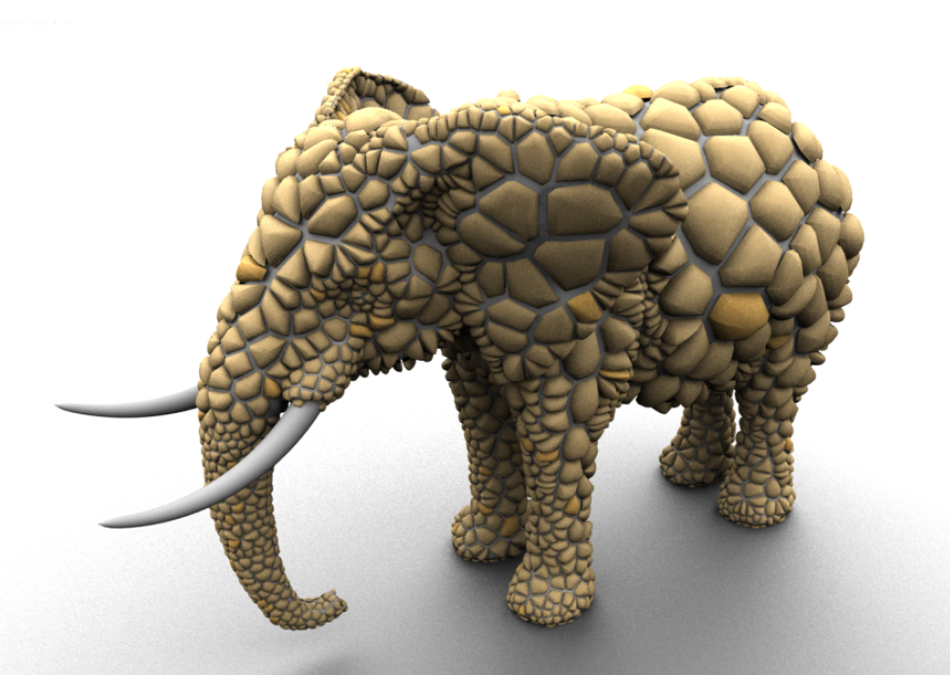
Voronoi Application
Post Office Problem:
Input: Set of Points PO (= Post Offices), Query Point p
Output: Nearest post office for p
Modeling, Pattern Generation

Slide 71
BSP Tree
BSP-tree: split node into 2 parts using a plane
2
1
2

